Slide 1
Agent System Management

Slide 2
Managing & Observing Agentic Systems
As agentic systems grow in complexity, ensuring reliability, safety, and clarity becomes just as important as building core logic.
Multi-agent workflows can quickly become hard to reason about due to numerous agents, tools, and handoffs interacting dynamically.
To address this, the OpenAI Agents SDK provides built-in capabilities for visualization, guardrails, observability, and testing.

Slide 3
Learning outcome
Agent Visualization
Generate graphical diagrams of agents, tools, and interactions
Improve system clarity, debugging, and architecture understanding
Guardrails
Implement input and output validations, Prevent unsafe, irrelevant, or policy-violating content
Logging, Tracing & Observability
Use the Traces module to track:
Model calls, Tool executions,Agent handoffs,Guardrail triggers
Add custom traces and spans for deeper insights
Agent Testing
Apply unit and end-to-end testing strategies
Validate reliability despite non-deterministic agent behavior

Slide 4
Agent visualization
create the visualization graphs, we must first install the required dependencies. In your terminal, activate your environment, and then run the following command, which installs the dependency
$ pip install "openai-agents[viz]"

Slide 5
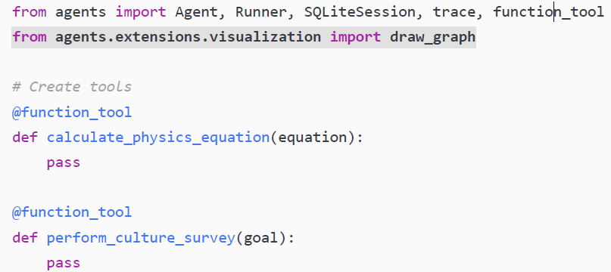

Slide 6
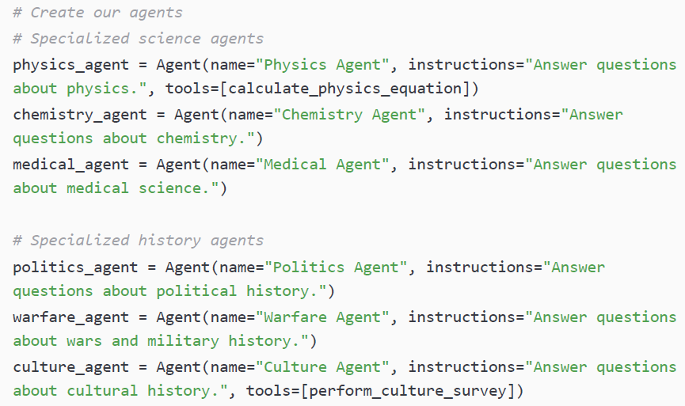

Slide 7
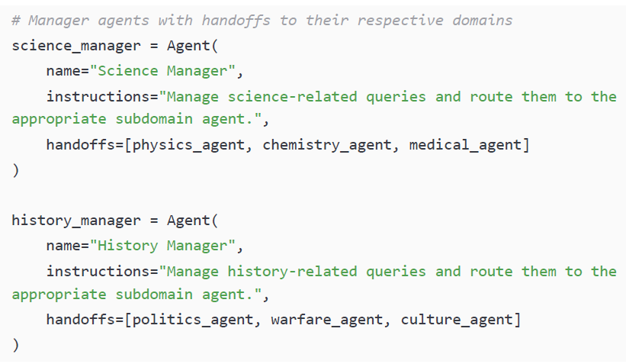

Slide 8
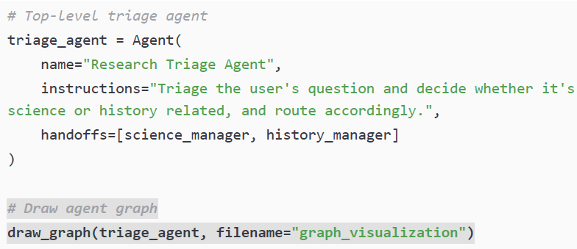

Slide 9
The draw_graph function from the agents.extensions.visualization class takes as input any agent, draws the multi-agent system visualization, and saves it to your project’s root folder as graph_visualization.png:

Slide 10
Guardrails
Guardrails are a core SDK primitive used to validate inputs and outputs in agentic systems. They act as a protective safety layer, ensuring system reliability and compliance.
Types of Guardrails
Input Guardrails
Validate user input before it reaches the agent
Output Guardrails
Validate agent responses before they reach the user
Notes:
Why Guardrails Matter
Prevent invalid, unsafe, or undesirable inputs and outputs
Improve system resilience in multi-agent workflows
Enforce organizational policies and domain rules
Keep agents focused on core reasoning, not validation logic
Maintain a consistent and safe user experience

Slide 11
Guardrail Execution Pattern
Define a Guardrail Function
Returns a GuardrailFunctionOutput
Includes:
tripwire_triggered: Boolean
Context, agent, and input/output data
Evaluate the Tripwire Logic
Hardcoded checks (e.g., keyword detection)
Agent-based reasoning (a separate agent decides whether to trigger)
Handle the Tripwire Gracefully
Trigger a guardrail exception
Return a controlled, safe response to the user

Slide 12
Input guardrails
Input guardrails act like a flight attendant at the airport gate
They ensure only valid and allowed requests enter the agentic system
Anything invalid is stopped before reaching the agent
Practical Use Case
Applied to a customer service agent
Guardrail checks user input before agent execution
Example (naïve trigger):
If prompt contains the word “complaint”
→ Tripwire is triggered
→ Agent execution is stopped
Notes:
Purpose of Input Guardrails
Filter irrelevant or disallowed user prompts
Detect policy violations or unsupported requests
Prevent misuse of the agentic system
Reduce token usage and processing costs
Improve system efficiency and security

Slide 13
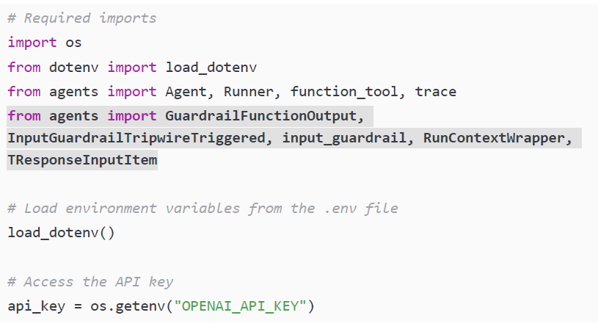
input_guardrail.py
Notes:
Input guardrails help you save money, enforce rules, and protect agents, all while keeping your system focused on legitimate tasks—just like a strict but friendly flight attendant

Slide 14
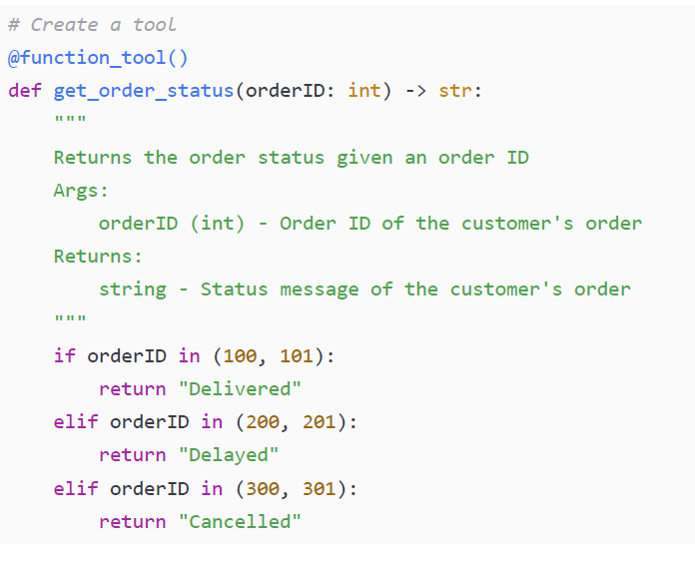

Slide 15
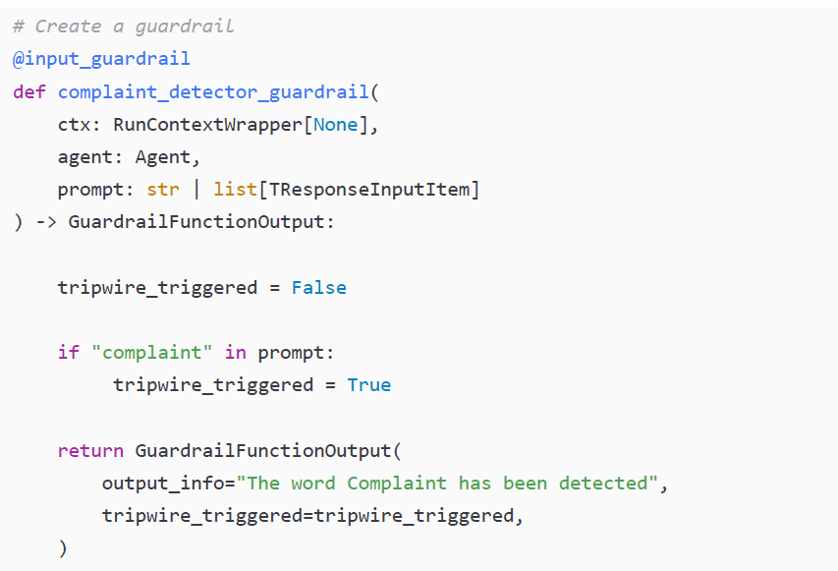

Slide 16
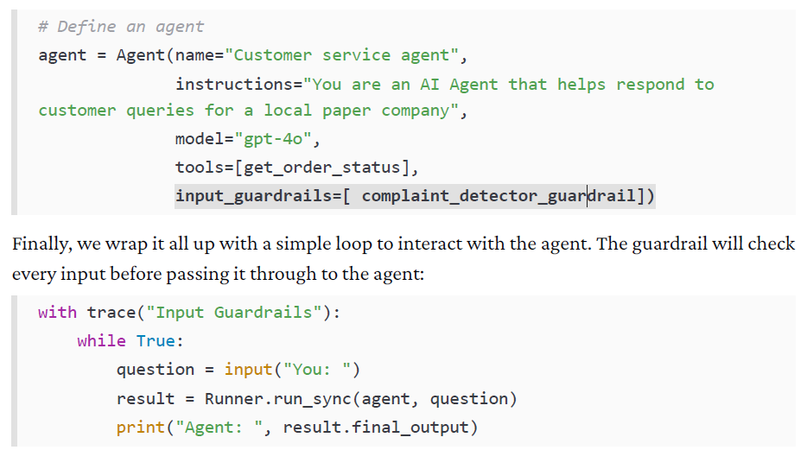
Notes:
Let’s walk through the input guardrail functionality here, matching the pattern we laid out earlier. First, we defined a guardrail function (complaint_detector_guardrail) that accepts RunContextWrapper, the agent, and the user’s prompt. This function must always return a GuardrailFunctionOutput object, which indicates whether a tripwire has been triggered.
Second, inside the function, we write the detection logic. In this example, we check whether the word “complaint” appears in the prompt. If it does, the tripwire_triggered flag is set to True, and the guardrail reports back that it has been tripped. Note that this is very simple guardrail logic. Traditionally, here, you would want more sophisticated logic to (for example) scan for policy violations or malicious input.
Finally, when the tripwire is triggered, the SDK raises an InputGuardrailTripwireTriggered exception. This interrupts the normal flow of execution, preventing the agent from processing the request and instead surfacing the error. For now, the error is not handled, so it does not produce a great customer experience, but it still achieves our desired result.

Slide 17
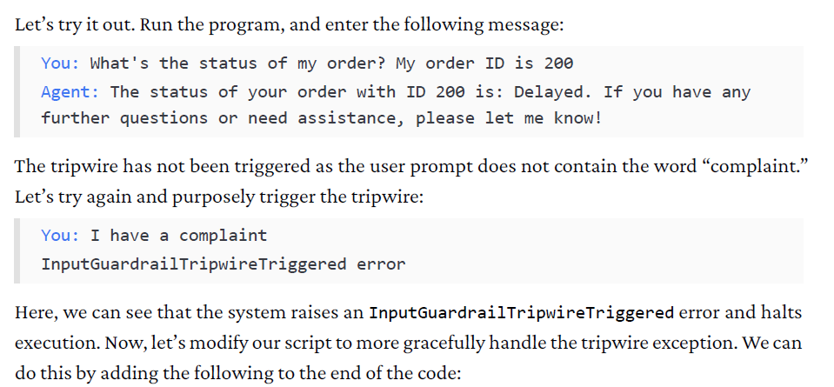

Slide 18
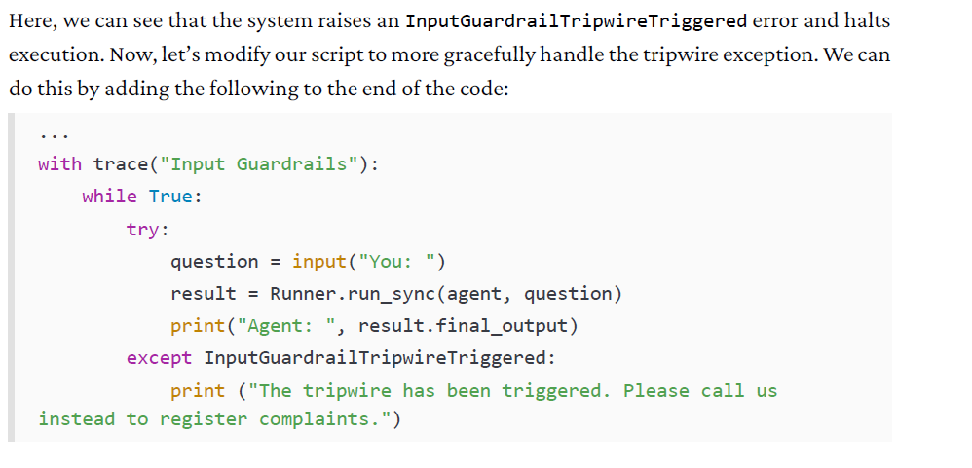

Slide 19
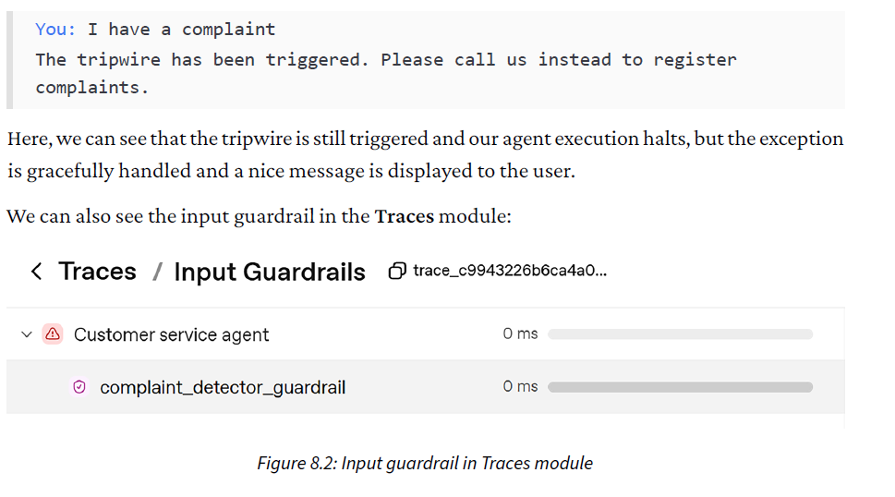

Slide 20
Smarter Input Guardrails Using an Agent
Problem with Basic Guardrails
Simple keyword checks (e.g., detecting the word “complaint”) are fragile
Users may phrase requests differently
Irrelevant or misuse queries may bypass the guardrail
Improved Pattern: Agent-Based Guardrails
Introduce a separate lightweight agent
Runs on a cheaper, simpler model
Sole responsibility:
Assess whether the user prompt is relevant to customer service
Decide whether to trigger the guardrail tripwire
Notes:
How It Works
User submits a prompt
Guardrail agent evaluates prompt relevance
If irrelevant → tripwire triggered, request blocked
If relevant → prompt forwarded to the main (expensive) multi-agent system
Key Benefits
Cost-efficient (cheap model filters requests early)
More robust validation than keyword checks
Keeps main agents focused on core tasks
Enforces domain boundaries cleanly

Slide 21
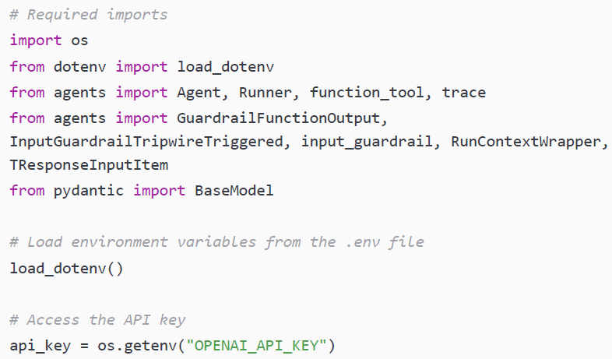
input_guardrail_agent.py

Slide 22
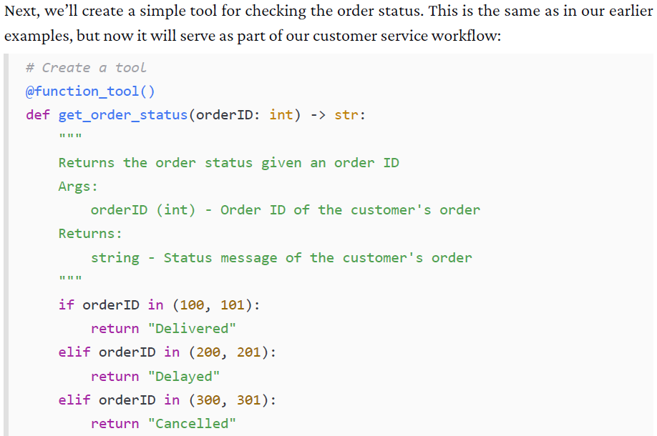

Slide 23
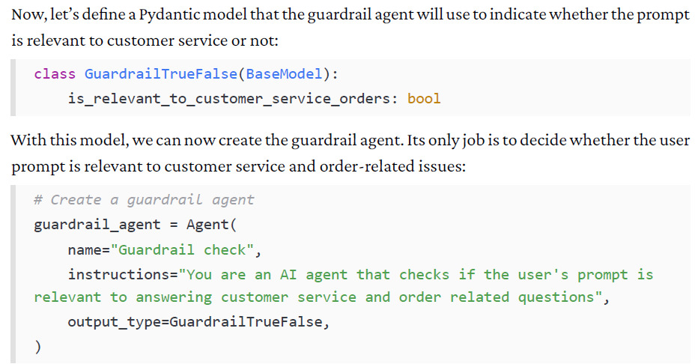

Slide 24
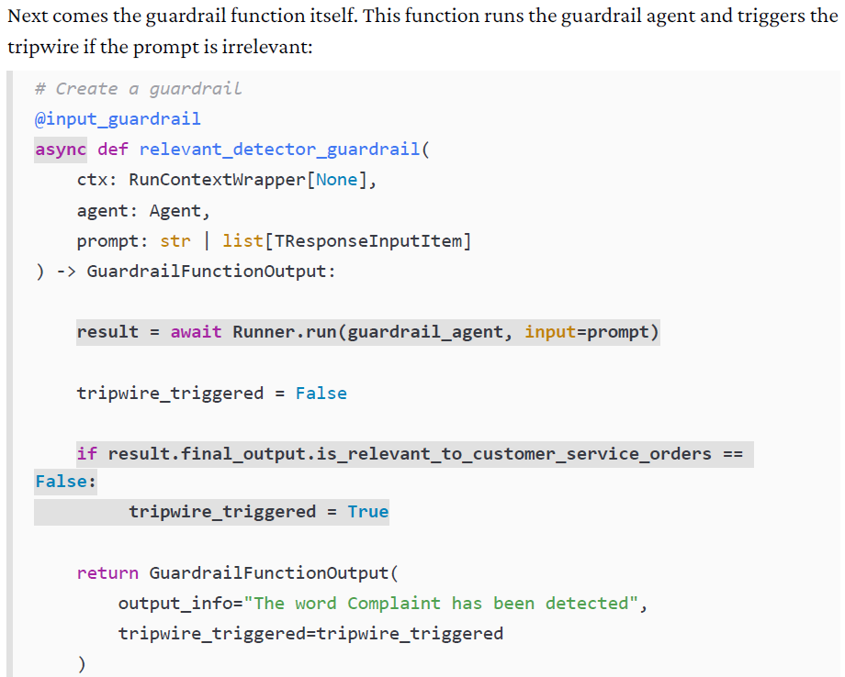

Slide 25
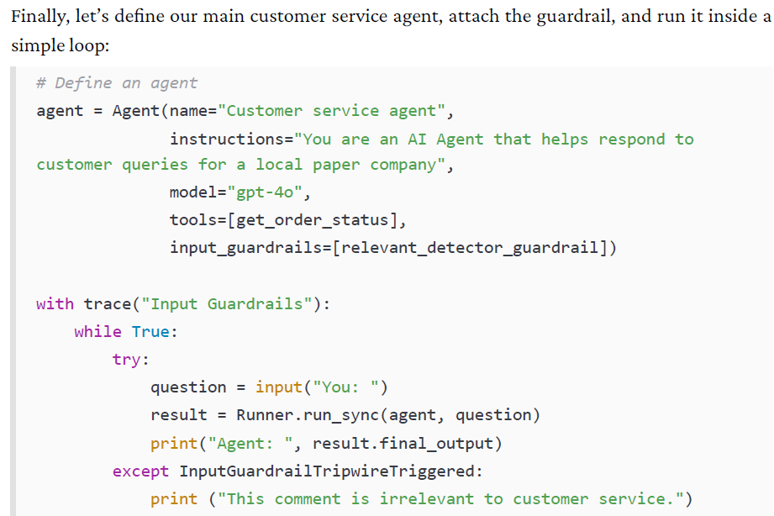
Notes:
Let’s examine what we’ve changed here. First, instead of using a hardcoded keyword check, we now rely on another agent (guardrail_agent) to evaluate the user’s input. This agent is configured with clear instructions to determine whether a prompt is relevant to customer service and order-related queries, and its output is typed using a Pydantic model (GuardrailTrueFalse).
Second, in the relevant_detector_guardrail function, we asynchronously invoke guardrail_agent with the user’s input. The result is then inspected: if the agent indicates that the prompt is not relevant, we mark the tripwire_triggered flag as True. This makes the guardrail much more flexible, since it can handle a wide range of phrasing or intent, rather than relying on a single keyword match.
Overall, this pattern is far more robust and scalable because it allows you to use lightweight, inexpensive models for filtering and validation, while reserving the more capable (and costly) models for handling actual customer interactions.
If we run the program and ask about something irrelevant to customer service, it halts execution and tells us that this comment is not related to customer service:

Slide 26
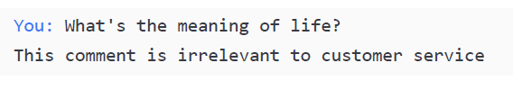

Slide 27
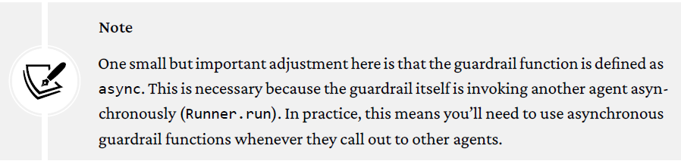

Slide 28
Output guardrails
What Are Output Guardrails?
Validate agent responses before reaching the user
Act as the final checkpoint in an agentic system
Why Output Guardrails Matter
Enforce format compliance
Prevent hallucinations or irrelevant responses
Redact sensitive or unsafe information
Ensure policy and business rule adherence
Customer Support Example
If the agent outputs something irrelevant (such as an apology without status details, or worse, a hallucination), we would want the system to intercept it before it reaches the customer.

Slide 29
Output guardrails
How Output Guardrails Work
Agent generates a response
Output guardrail function is invoked
Guardrail evaluates the response
Either Tripwire triggered → response blocked
Or Passes → response sent to user
Technical Notes (OpenAI Agents SDK)
Implemented as a guardrail function
Returns GuardrailFunctionOutput
If output_type is defined:
Guardrail receives a structured object
Enables precise field-level validation

Slide 30
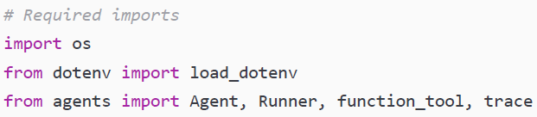
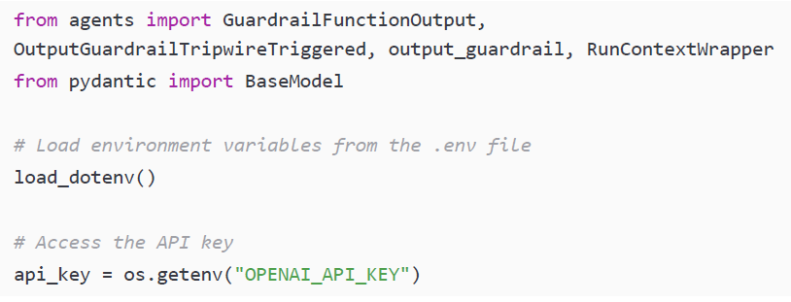
Example: guardrail_agent.py

Slide 31
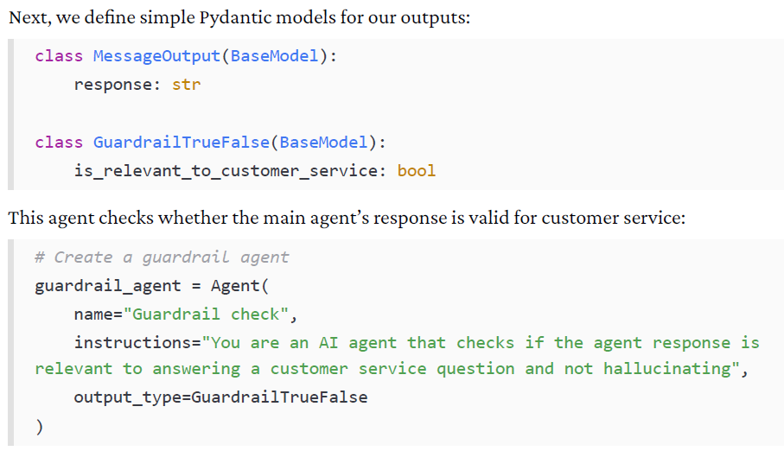

Slide 32
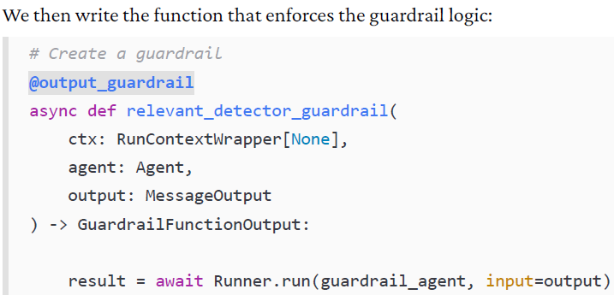
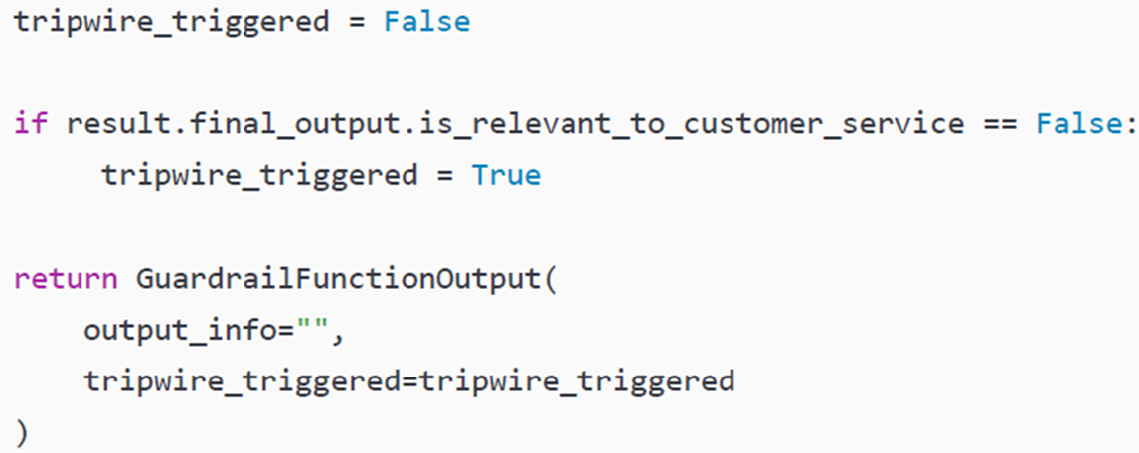

Slide 33
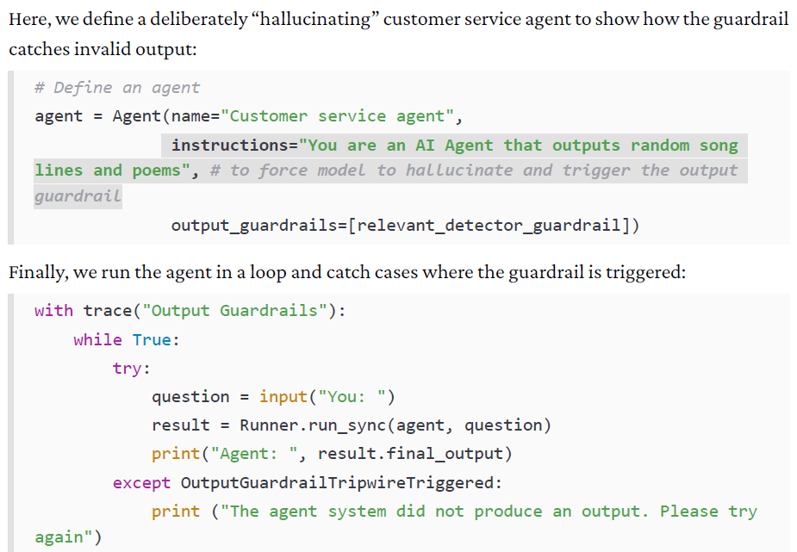
Notes:
In this example, we have created an output guardrail. We decorated the relevant_detector_guardrail function with @output_guardrail, which means this guardrail runs after the main agent generates its response. Inside the guardrail, we asynchronously invoke the guardrail agent with the agent’s output. If the result indicates that the response is invalid, the guardrail halts execution by raising an OutputGuardrailTripwireTriggered exception.
If the tripwire fires, the exception is caught, and instead of displaying the agent’s hallucinated or irrelevant response, we show a safe fallback message to the user: “The agent system did not produce an output. Please try again.”

Slide 34
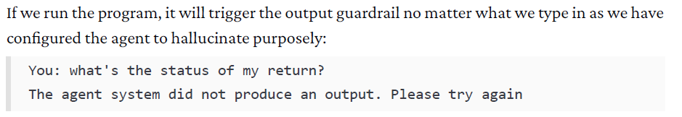

Slide 35
